Slide 1
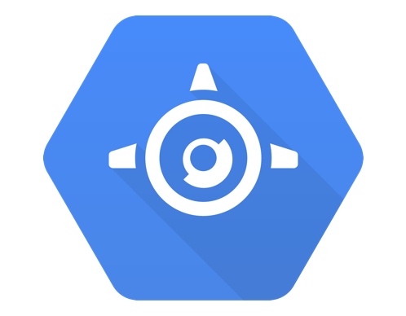
Google Cloud App Engine

Slide 2
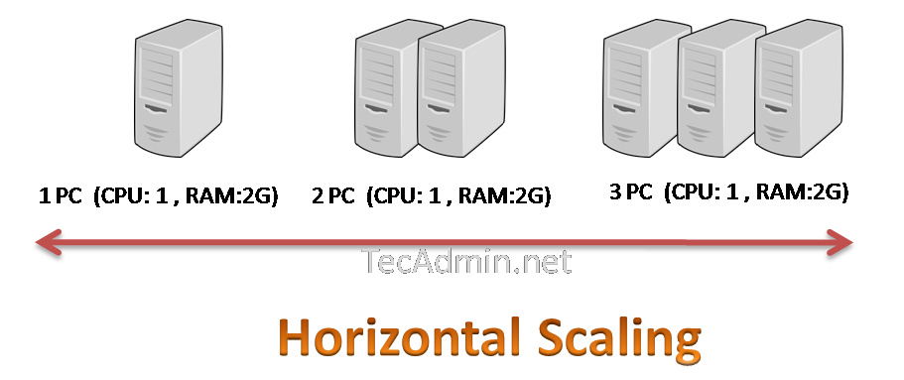

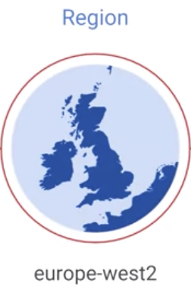

What is App Engine?
App Engine is a fully managed, serverless platform for developing and hosting web applications at scale. You can choose from several popular languages, libraries, and frameworks to develop your apps, and then let App Engine take care of provisioning servers and scaling your app instances based on demand.
An App Engine application is a high-level resource created in a project; that is, each project can have one App Engine application. All resources associated with an App Engine app are created in the region specified when the app is created.
App
Stuff

Slide 3



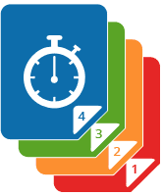
App Engine Components
App Engine Standard applications consist of four components:
Application
Service
Version
Instance
An application that the customer needs is a combination of multiple services, where each service can have various versions that are deployed in instances
A service can have multiple versions, and these are usually slightly different, with newer versions incorporating new features, bug fixes, and other changes relative to earlier versions.
Apps have at least one service, which is the code executed in the App Engine environment
When a version executes, it creates an instance of
the app.

Slide 4
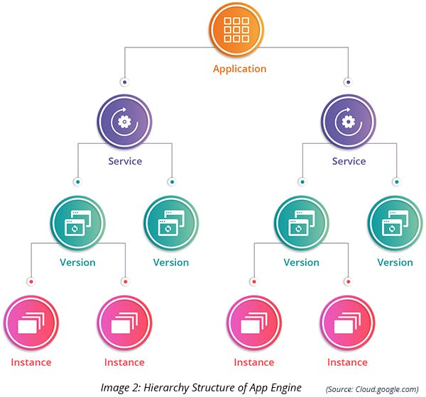
The component hierarchy of App Engine applications

Slide 5


App Engine Use Cases
The best use cases to use the App Engine are those where you want zero downtime and you don’t want to:
configure and manage application infrastructure.
control security, firewalls, and SSL certificates of an application.
install and maintain packages required for the application.
It is better not to opt for App Engine when:
having control over an underlying instance, configurations, and packages are required.
You need to run the application with customized images

Slide 6
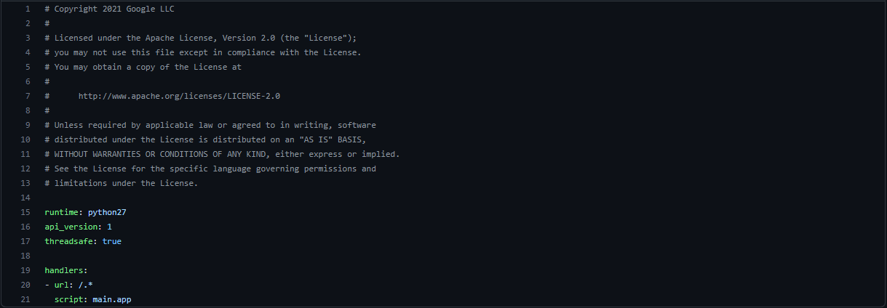
Deploying Apps
An application resource can host many services, where each service runs your own application.
Services are defined in a file called app.yaml
Here is an example app.yaml file

Slide 7
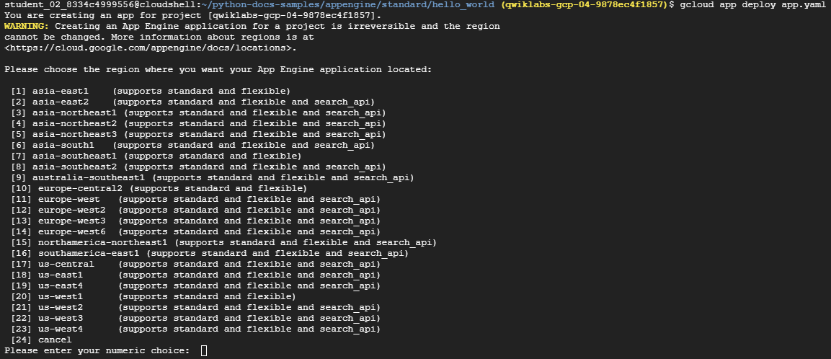

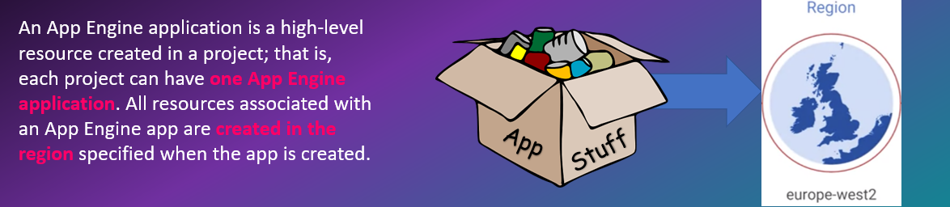
Gcloud app deploy

Slide 8

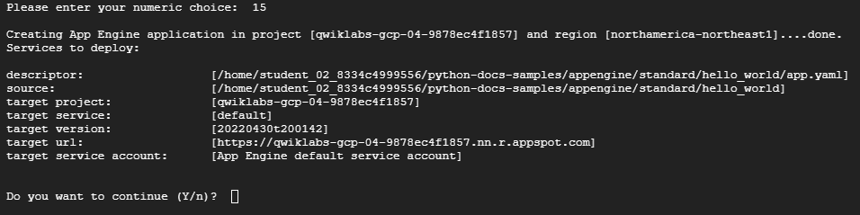
What`s next?

Slide 9

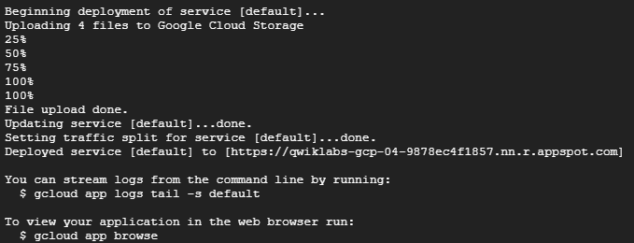
Then

Slide 10
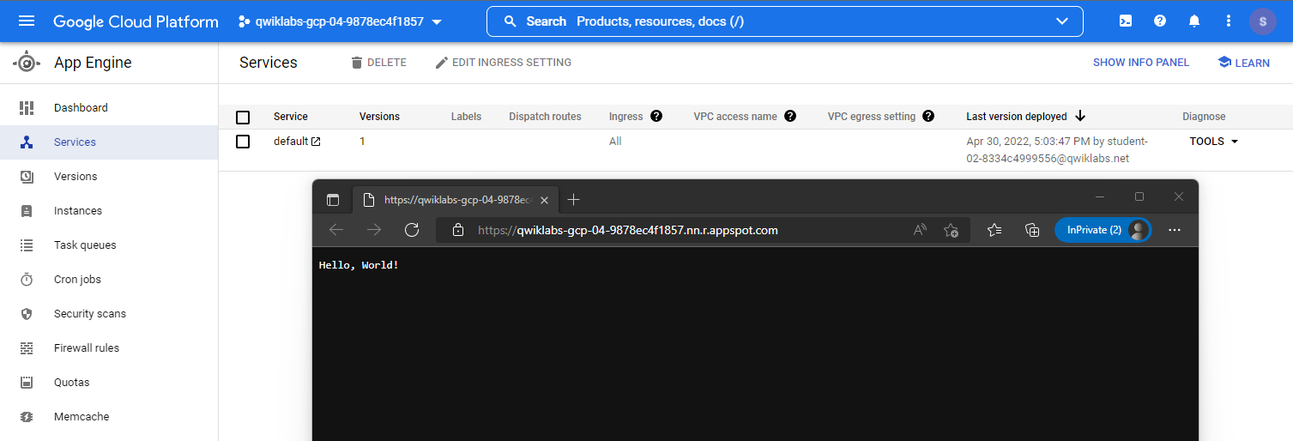
Cloud Console View

Slide 11
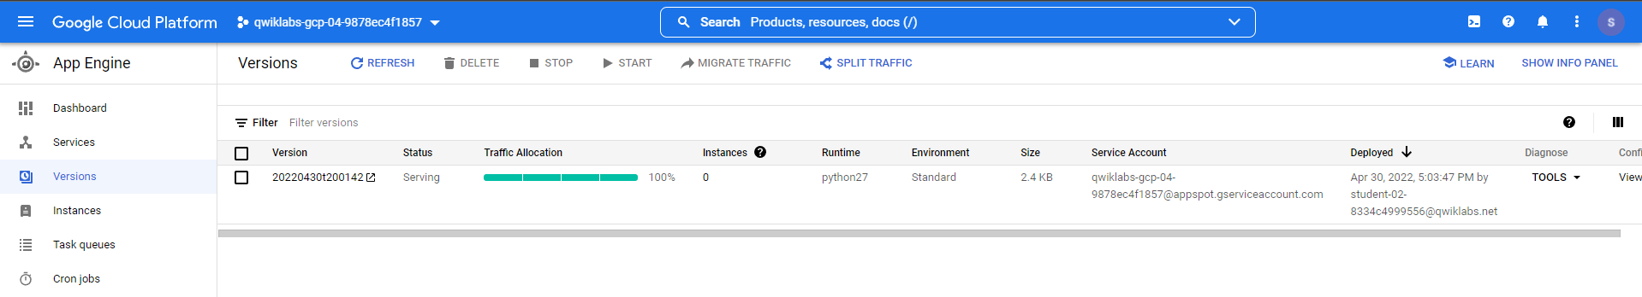

Traffic Split View
Because there is only just one instance all the traffic is serving this application
version

Slide 12
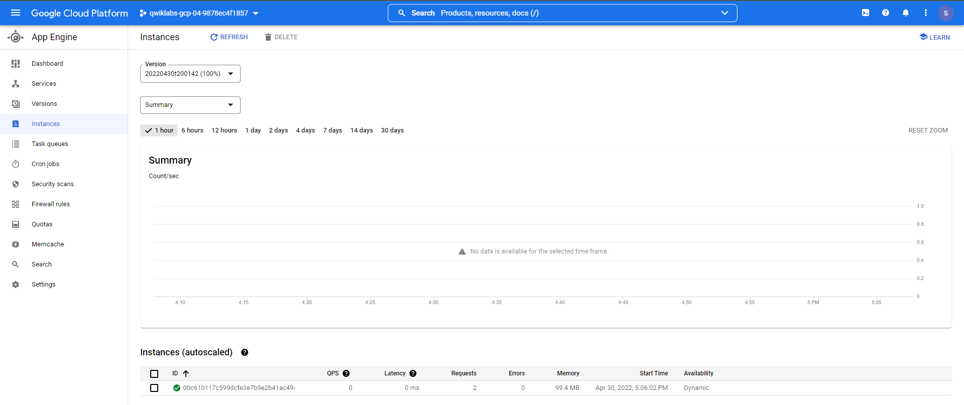
Deployed Instance

Slide 13
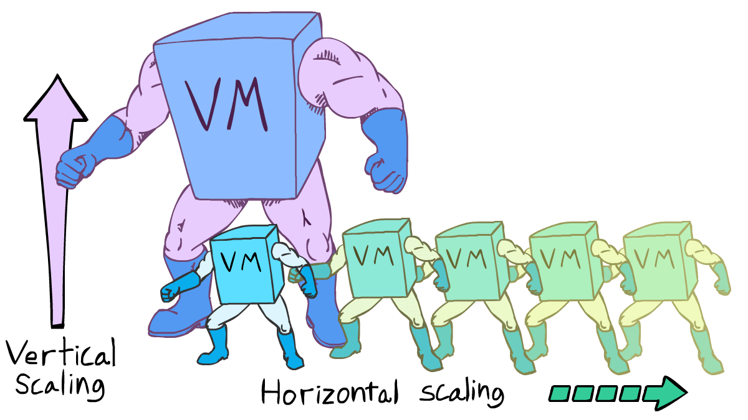

Scaling App Engine Applications
Instances are created to execute an application on an App Engine managed server. App Engine can automatically add or remove instances as needed based on load. When instances are scaled based on load, they are called dynamic instances. These dynamic instances help optimize your costs by shutting down when demand is low
Alternatively, you can configure your instances to be resident or running all the time. These are optimized for performance so users will wait less while an instance is started. Your configuration determines whether an instance is resident or dynamic. If you configure autoscaling or basic scaling, then instances will be dynamic. If you configure manual scaling, then your instances will be resident.

Slide 14
Scaling App Engine Applications
To specify automatic scaling, add a section to app.yaml that includes the term automatic_scaling followed by key-value pairs of configuration options.
These include the following:
■ target_cpu_utilization
■ target_throughput_utilization
■ max_concurrent_requests
■ max_instances
■ min_instances
■ max_pending_latency
■ min_pending_latency
Target CPU Utilization Specifies the maximum CPU utilization that occurs before additional instances are started.
Maximum number of concurrent requests before additional instances are started. Between 0.5 and 0.95.
Specifies the max concurrent requests an instance can accept before starting a new instance. The default is 10; the max is 80
Range of number of instances that can run for this application
Indicates the maximum and minimum time a request will wait in the queue to be processed

Slide 15



Splitting Traffic between App Engine Versions
If you have more than one version of an application running, you can split traffic between the versions.
IP address
HTTP cookie
Random selection
IP address splitting provides some stickiness, so a client is always routed to the same split, at least as long as the IP address does not change
HTTP cookies are useful when you want to assign users to versions
Random selection is useful when you want to evenly distribute workload
GOOGAPPUID

Slide 16

Preferred Way
The preferred way to split traffic is with a cookie. When you use a cookie, the HTTP request header for a cookie named GOOGAPPUID contains a hash value between 0 and 999.
With cookie splitting, a user will access the same version of the app even if the user’s IP address changes. If there is no GOOGAPPUID cookie, the
n the traffic is routed randomly

Slide 17

What`s the preferred way to split traffic?

Slide 18

Cookie
GOOGAPPUID

Slide 19
Traffic Splitting
The command to split traffic is
gcloud app services set-traffic
Here’s an example:
gcloud app services set-traffic serv1 --splits v1=.4,v2=.6
This will split traffic with 40 percent going to version 1 of the service named serv1 and 60 percent going to version 2. If no service name is specified, then all services are split.
The gcloud app services set-traffic command takes the following parameters:
■ --migrate indicates that App Engine should migrate traffic from the previous version to the new version.
■ --split-by specifies how to split traffic using either IP or cookies. Possible values are ip, cookie, and random.

